Slide 1

The Jordan Institute Fellowship for Social Work Leaders
Applicant Information Session
August 18, 2025, 12-1pm

Slide 2
Agenda for today’s session
Welcome
Brief overview of the Jordan Institute for Families
About the Fellowship
Audience Q&A
Note: The session will not be recorded. However, a write up of all questions and answers will be posted on our website.

Slide 3
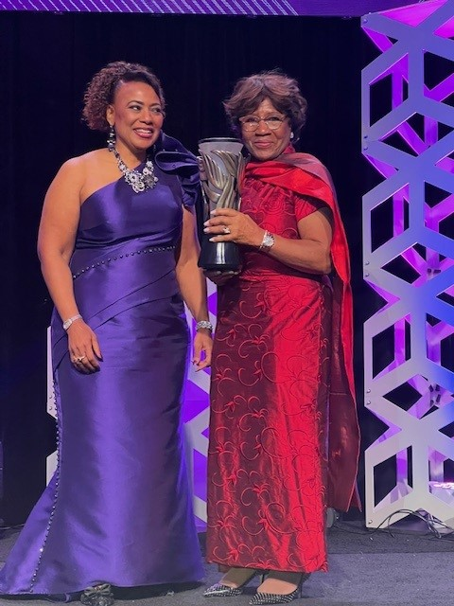
About Us
Founded in 1996 by Michael Jordan and his family, the Jordan Institute for Families’ vision is to ensure that all families have the support they need to thrive. We focus on strengthening families, communities and the workforce who serves them. In alignment with the UNC School of Social Work – our home base – JIF is committed to advancing equity, transforming systems and improving the lives of families in and beyond North Carolina.
We are grateful to Mrs. Deloris Jordan for inspiring us to make this happen!
www.JordanInstituteforFamilies.org

Slide 4

Thank you to our Advisory Group!

Slide 5
Why this Fellowship?
The Problem:
Scarcity of professional development opportunities for mid-level social workers –particularly those in management and leadership roles.​
Lack of support to navigate personal, professional, and organizational challenges.​
Increasing amount of burn out and turnover.​
Need for ongoing education and skill building to lead effectively, efficiently, and sustainably in changing environments
Overarching Goals:
This program will fill a gap in the professional development landscape for social workers by providing support, information, and skills, to aid professionals in navigating personal, professional, and organizational challenges. ​
The program will provide opportunities to mitigate burn out and turn over. ​
Professionals will develop skills and have access to information to lead effectively, efficiently, sustainably, and authentically.

Slide 6
Fellowship Structure
The 2025 cohort will be the inaugural class of the fellowship.
We will select up to 20 social workers who lead or manage programs in North Carolina and are mid-career.
This is a 6-month program, free of charge, and largely virtual, with a few opportunities for in-person retreat.
The Fellowship is designed to offer a mix of skill-building, peer connection, and reflective practice.
Our approach focuses on three areas – leading oneself, leading teams, and leading organizations.
Each fellow will have the chance to craft and begin to implement a personal / professional development plan.
Fellows will have a variety of supports available to assist them including access to experts, coaching, training materials, and additional workshops/webinars.

Slide 7
Applicant Requirements and Expectations
North Carolina-based social work professionals who have worked in a managerial or leadership role for at least 5 years.
We hope to engage with social work leaders from a variety of backgrounds, including those who serve in rural areas, work in agencies of different sizes, and people with different identities, perspectives and focus populations.
Fellows will commit to the full 6-month program and attend most of the workshops and gatherings.
There is NO financial cost to apply or participate in the fellowship.

Slide 8
Fellowship Curriculum
Advancing Organizational Well-being with Trauma-Informed Leadership
Crucial Conversations
Hot Topics in Leadership
Joy & Rest
Dreaming Change into Broken Systems
Continuous Quality Improvement
Funding the Work
Abundance Mindsets
Supporting Teams and a Diverse Workforce
Working Across Difference
Building Influence and Shifting P(p)olicy
Power Analysis and Networking Skills

Slide 9
Application Information
Applications are due by midnight on Monday, September 15th
The application is currently open
All responses need to be 300 words or less
All application questions are available on our website for those who may wish to reflect on them in advance
Application decisions: September 29th
Deadline to accept Fellowship: October 3rd
Accepted applicant welcome webinar: October 9th from 12-1pm

Slide 10

Audience Questions Type your questions in the chat or unmute to ask your question A write up of all questions and answers will be posted on our website.

Slide 11
Questions?
Email – jordaninstitute@unc.edu
Visit Our Website:
jordaninstituteforfamilies.org
Follow Us on LinkedIn:
linkedin.com/company/jordan-institute-for-families/

